Slide 1


SINGLE-WALLED UST
OUTREACH AND RUST
Johnny Wales,
Environmental Specialist/Project Manager
W-C2
Wednesday, February 28th, 2024
26th California Unified Program
Annual Training Conference
February 26-29, 2024

Slide 2
Agenda
Single-walled UST (SWT) Closure requirements
Progress, Tracking, Metrics
RUST Grants and loans, AN Overview

Slide 3
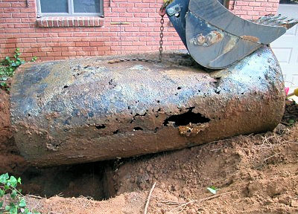
Why this is Important
Why phase out single-walled USTs?
Freedom from environmental contamination and access to clean, safe drinking water
From 2017 to 2022, 29.7% of Single-walled UST closures have resulted in a new leaking underground storage tank case, vs. 6.7% for double-walled USTs.

Slide 4

12/31/2025 Single-walled Closure Deadline
12/31/2025 Single-walled Closure Deadline
Senate Bill 445 became effective September 25, 2014.
Amended State Law, the California Health and Safety Code (H&SC) section 25292.05.
Requires the permanent closure of single-walled tanks and piping.

Slide 5

12/31/2025 Single-walled Closure Deadline
2
12/31/2025 Single-walled Closure Deadline
Tanks and/or piping that do not meet the requirements of H&SC, section § 25291(a)(1)–(6) must be permanently closed on or before December 31, 2025
Per H&SC § 25281 (definition of a UST), piping connected to a UST is part of the UST
What is a tank that is constructed according to the requirements of H&SC, § 25291(a)(1)–(6)?

Slide 6
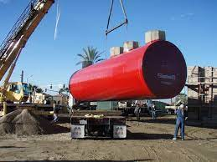
USTs constructed according to H&SC
§ 25291(a)(1)–(6):
USTs constructed according to H&SC
§ 25291(a)(1)–(6):
Designed and constructed to have primary and secondary levels of containment (double-walled).
Primary containment is product-tight (liquid-tight)

Slide 7
USTs constructed according to H&SC
§ 25291(a)(1)–(6) (continued)
USTs constructed according to H&SC
§ 25291(a)(1)–(6):
Continuous leak detection system capable of detecting the entry of the stored substance from the primary containment into the secondary containment.
Continuous leak detection system capable of detecting water intrusion into the interstitial space from the environment.

Slide 8
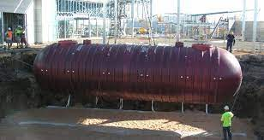
Scenario 1: Single-Walled Tank with Single-Walled Piping
Scenario 1: Single-Walled Tank with Single-Walled Piping
Entire UST system must be permanently closed.
Construction/monitoring requirements are a function of tank installation date; when the single-walled tank is replaced, new requirements are triggered.
This means the UST system becomes subject to vacuum, pressure, or hydrostatic (VPH) monitoring, must be liquid tight/vapor tight, etc.

Slide 9
Scenario 2: Single-Walled Tank with Double-Walled Piping
Scenario 2: Single-Walled Tank with Double-Walled Piping
When the single-walled tank is replaced, current construction and monitoring requirements are triggered.
The existing piping becomes subject to the requirements of H&SC § 25290.1.
This means the existing piping will be required to be monitored with vacuum, pressure, or hydrostatic (VPH) fluid, must be liquid-tight/vapor-tight, etc.

Slide 10
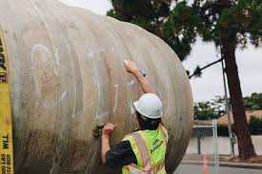
Scenario 2: Single-Walled Tank with Double-Walled Piping 2
Scenario 2: Single-Walled Tank with Double-Walled Piping (Cont’d)
Existing DW piping can only remain in place if the piping is approved for use by UL for VPH monitoring and can operate in accordance with § 25290.1 (VPH, liquid/vapor tight). Not recommended.
Risers, vent, and vapor recovery lines also become subject to the requirements of § 25290.1 (VPH monitoring, liquid/vapor tight).

Slide 11
Scenario 3: Double-Walled Tank with Single-Walled Piping
Scenario 3: Double-Walled Tank with Single-Walled Piping
Piping shall meet the requirements of H&SC section § 25291(a)(1)–(6).
Safe suction piping connected to tanks installed before July 1, 2003 is not subject to H&SC § 25292.05, but I will need confirmation that a proper inspection method is in place.
Fill risers, vapor recovery lines, vent lines, connected to tanks installed before July 1, 2003 may not be subject to H&SC § 25292.05.

Slide 12
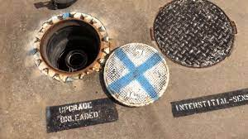
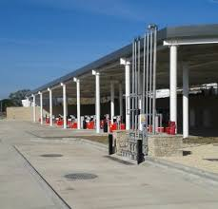
Vapor Recovery Lines
Vapor Recovery Lines, Fill Risers and Vent Lines
For USTs installed before July 1, 2003, if VR lines do not hold standing fluid, VR lines are not subject to H&SC § 25292.05
Vent and fill risers are not subject to H&SC § 25292.05 if the UST was installed before July 1, 2003 and has either: a ball float that restricts flow 30 mins prior to overfill and allows no more than 95% capacity AND an audible/visual alarm that activates at least 5 minutes before overfill, OR positive shutoff at 95%..

Slide 13
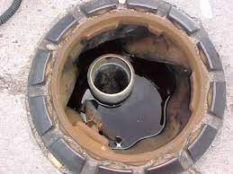
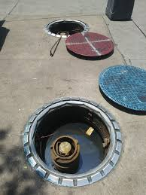
USTs constructed according to H&SC
§ 25291(a)(7) slide 2
Single-Walled Vent and Riser Piping
DW tanks with SW vent/riser piping and improper Overfill Prevention Equipment (OPE)—already out of compliance
This means USTs with SW vent/riser piping, if not equipped with fill tube shutoff or flow restrictor combined with Audible/Visual alarm, must either: secondarily contain vent/riser piping, or upgrade OPE to positive shutoff

Slide 14
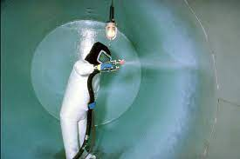
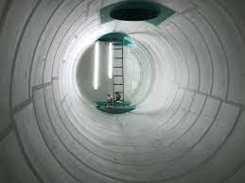
Interior Lined-Tanks
Interior Lined-Tanks and Tanks with Bladders
Single-walled tanks that were lined must be permanently closed.
Single-walled tanks with rigid and flexible bladders must be permanently closed.
Liners, coatings, nor bladders meet H&SC § 25291(a) secondary containment requirements.

Slide 15

What is Permanent Closure
What is Permanent Closure?
Permit from Unified Program Agency (UPA) is required
All liquids, solids, sludge in the tank must be removed and handled as hazardous substance.
Tank must be rinsed, inerted, removed, and disposed of properly.

Slide 16
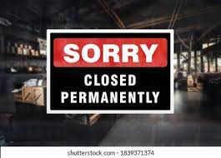
What is Permanent Closure? continued
What is Permanent Closure?
All piping and accessories must be removed and disposed of properly.
Soil samples analysis and/or water analysis if water is present in the excavation is required immediately after tank removal to determine if an unauthorized release has occurred.
Closure in place may be an option in limited situations, and only when approved by the UPA.

Slide 17

Penalties
Penalties
Beginning January 1, 2026, single-walled USTs that have not been properly permanently closed will be out of compliance and may eventually be red-tagged, preventing fuel deliveries and dispensing, and civil penalties of no less than $500 and not more than $5,000 per day, per tank, per violation, will begin to accrue.

Slide 18
Penalties
SWT Universe
US EPA’s Semi-Annual Leak Prevention Reports are linked here:
From Jan – Dec 2021 SALPR: From Jan – Dec 2022 SALPR:
(CERS Data pulled 4/1/22) (CERS data pulled 5/12/23)
California Single-Walled USTs
 | SW Tank | DW Tank SW Piping | Total
USTs | 1,838 | 535 | 2,373
Facilities | 666 | 312 | 962
California Single-Walled USTs
 | SW Tank | DW Tank SW Piping | Total
USTs | 1,754 | 333 | 2,087
Facilities | 640 | 158 | 794

Slide 19
Penalties
Johnny’s SWT Numbers
From GeoTracker (https://geotracker.waterboards.ca.gov):
California Single-Walled USTs
 | Abandoned SWTs | SWT-No Plan Returned | SWT-Confirmed Plan | Federally owned SWTs | Safe Suction Piping Verified by CUPA | Totals
SWTs | 94 | 513 | 78 | 15 | N/A | 700 | 1,032
DWTs w/SW Piping | 9 | 246 | 10 | 4 | 63 | 332
Facilities | 40 | 620 | 34 | 7 | 33 | 734

Slide 20

Penalties
Johnny’s SWT Numbers—why so different from CERS?
Difficulty getting the responsible parties to make updates to reflect:
    Tank closures
    Double-walled tanks/piping mistakenly reported as single-walled

Slide 21
Penalties
Johnny’s Closed SWT Numbers
From GeoTracker (https://geotracker.waterboards.ca.gov):
California Single-Walled USTs Closed (Since We Started Tracking In 2022)
 | USTs Permanently Closed – Report Pending | USTs Permanently Closed – Report Received | Totals
SWTs | 220 | 54 | 274
DWTs w/SW Piping | 21 | 6 | 27
Facilities | 93 | 22 | 115

Slide 22
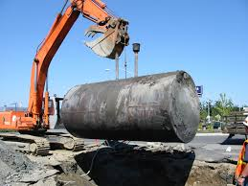
Penalties
Johnny’s Closed SWT Tracking
Changes to UST closure reporting may be coming
US EPA would like for every UST closure sampling report to be available to the public in GeoTracker, along with:
  The status of the Cleanup Oversight Agency’s review of the report
  The outcome of the Cleanup Oversight Agency’s review—is a new LUST case needed?

Slide 23

RUST Program Overview
RUST (Replacing, Removing or Upgrading USTs) = grants and loans
Assists eligible small business UST owners/operators to come into compliance with UST regulatory requirements
Any eligible UST owner/operator may apply; program is not limited to single-walled sites

Slide 24

RUST Program Overview
Application must be reviewed and approved, and a grant/loan Agreement must be EXECUTED before reimbursable work can begin
Invoices are paid only AFTER work is performed
Apply through FAAST: https://faast.waterboards.ca.gov/

Slide 25
RUST Program Urgency
This is the last time we will be giving this presentation with any expectation that it will help anyone to receive RUST funding to assist with meeting the 12/31/25 deadline
Reviewing a RUST application, drafting and executing grant/loan Agreements, and processing invoices all take time…

Slide 26

Important Deadlines
AB 1115 extended the UST Cleanup Fund, but this did not change the single-walled UST closure deadline; it’s still December 31, 2025
UST Cleanup Fund (including RUST) sunsets –
January 1, 2026 2036

Slide 27

Important Deadlines
Corrective Action Claim application submittal to UST Cleanup Fund for reimbursement of eligible costs – December 31, 2024 2034
SWRCB’s Division of Financial Assistance does not execute new grant/loan Agreements or release payment of invoices between April and mid-July of each year

Slide 28


Who can apply for RUST?
Either the UST owner or operator small business entity
  No Non-Profit Organizations
  No Government Entities
When the UST owner and operator are separate entities, eligibility is determined separately
Anyone who is issued a valid UST operating permit can be considered a UST operator

Slide 29

Who can apply for RUST?
Probate proceedings must be settled before a property owner can apply
If the RUST applicant is the UST Operator, there must be a Lease in place that will cover the life of the grant/loan Agreement (10 or 20 years, or the option of either)

Slide 30
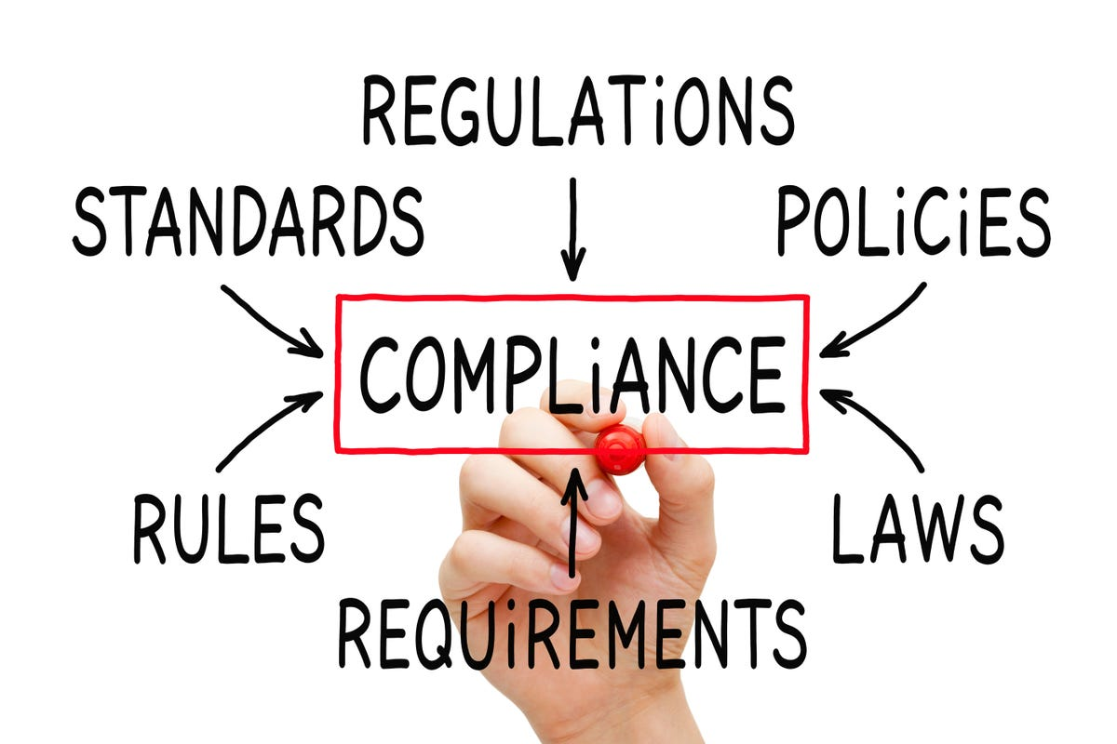
Eligible Applicants (All)
Small Business Petroleum UST Owner and/or Operator, domiciled in California (including all named corporate officers, co-owners, members, and business headquarters)
  Project Facility must have a current,
  accepted CERS UST submittal
  Any other facilities owned/operated by named applicant must be 100% in compliance with UST Regs and H&SC

Slide 31

Eligible Tanks
Petroleum Underground Storage Tanks
  No tanks that do not meet the 23 CCR
  Chp. 16 definition of a UST
  No Heating Oil USTs, whether regulated-commercial or exempt-residential
  Waste Oil UST projects ARE eligible!
  Facility must have been a business at some point

Slide 32

Eligible Applicants, Grants
Applicant must:
  have fewer than 20 employees
  have retailed fuel within the last 2 years, but sells fewer than 1,500,000 gallons of gasoline per year
  USTs are not red-tagged or subject to administrative civil liability, civil liability, or criminal liability, unless the underlying violations have been corrected

Slide 33

Eligibility, Grants
  Project facility must be compliant with H&SC Chapter 6.7 and adopted regulations and EVR requirements, unless the application is received within 180 days of receiving the violation(s), AND the work will bring them into compliance

Slide 34

Grants
Between $3K to $70K maximum per entity
  If application is approved, they are approved for the FULL grant amount. Anything unspent remains available for future applications.
Includes UST removal-only work
An additional $140K in grant funds (for a total of $210K) is available for single-walled UST replacement, if the nearest public fueling facility is more than 15 miles’ driving distance away

Slide 35

Grant Waiver
  If the UST facility does not meet RUST’s compliance requirements, or has not retailed motor vehicle fuel within the last two years, these normal eligibility requirements can be waived, if:
    The grant application is for a UST removal-only project, AND
    The applicant demonstrates that they are unable to afford a RUST loan for the cost of the removal project

Slide 36

Waiver Grant
  Other RUST grant eligibility requirements still apply
  While the RUST grant application forms are written for active businesses, the applicant can provide a signed statement that explains why most of the documents that are normally required are unavailable

Slide 37

Eligible Applicants, Loans
Applicant must have fewer than 500 employees
Project facility is not required to retail fuel
Applicant must be able to demonstrate ability to repay loan and possess adequate collateral
Applicant must be compliant with Financial Responsibility requirements

Slide 38

Eligibility, Loans
Project tanks must be in compliance with H&SC Chapter 6.7, UST Regulations, and EVR requirements, unless the work will bring them into compliance
  (there’s no 180-day time limit as with grants)
  all administrative violations must be resolved

Slide 39

Loans
$10K to $750K maximum per entity
10- or 20-year terms:
  Guarantee is required
  10-year loan: RUST takes a Uniform Commercial Code lien
  20-year loan: RUST takes a UCC lien and a Deed of Trust
Below Market Interest Rate—Currently: 1.7%!
Two percent (2%) loan fee, due at closing

Slide 40
Eligible Business Entities
CA Secretary of State Business Search can help applicants and consultants demonstrate company ownership—see: RUST Loan App. Checklist
Application requirements are different for:
  Sole proprietorships
  Partnerships
  LLCs
Corporations
Trusts
Estates

Slide 41
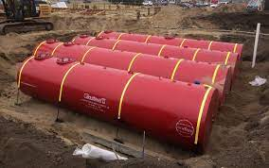
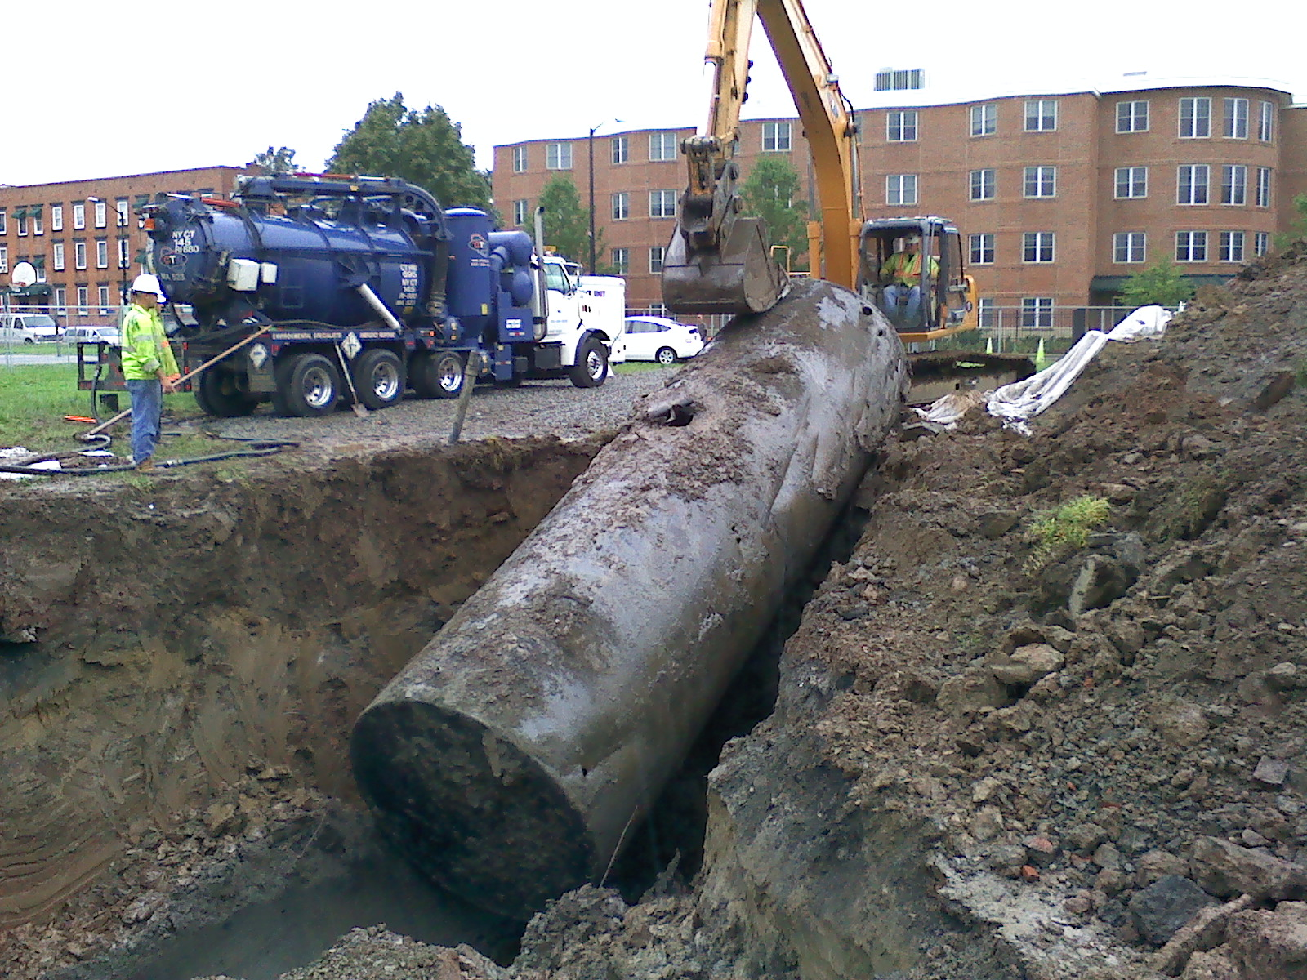
Typical Projects Covered
Removing and/or replacing USTs and/or piping
Repairing and/or upgrading USTs

Slide 42

Typical Repair/Upgrade Costs
Replace or repair secondary containment, including penetration fittings, test boots, and/or containment sumps
Replace under-dispenser containment
Replace or repair spill buckets, fill pipes, and/or overfill protection devices
Replace electronic monitoring system
Conduct enhanced leak detection test
Replace manway covers
Enhanced vapor recovery upgrades

Slide 43

Typical Ineligible Costs
Aboveground Storage Tanks – exception: If replacing UST with an AST, will fund costs associated with removal/disposal of the UST only
Non-qualifying dispensers – unless replacing entire fueling system or for an environmental reason
Payment Card Industry/Point of Sale equipment
Signage, decals, bollards, speakers, and monitors
Canopies, valances, cash registers, fuel software, travel, and convenience store-related expenses
Costs of back-owed permit fees and penalties

Slide 44


Common RUST Application Issues
Missing required documents/missing signatures
Documents are redacted
Documents expire after submittal due to delays
Mixing and matching documents/finances of different business entities
Contractor’s Proposal:
  Not itemized to show labor and equipment costs or missing material list
  Proposal missing required tasks

Slide 45

Common RUST Application Issues
Discrepancies between applicant named and CERS/Permits
Open CERS violations
CERS shows the wrong name of owner or operator, or the wrong size/number of USTs
Property Grant Deed must show Complete Legal Description of the property

Slide 46

RUST Program Information
For more information, visit our website at:
http://www.waterboards.ca.gov/water_issues/programs/ustcf/rust.shtml
Join our Electronic Notification List to receive Program updates:
http://www.waterboards.ca.gov/resources/email_subscriptions/swrcb_subscribe.shtml#financialy
Email:: RUST@Waterboards.ca.gov

Slide 47
Any Questions?
Johnny Wales
Redhorse Corporation
Environmental Specialist/Project Manager
Johnny.Wales@Waterboards.ca.gov
804-852-7274
26th California Unified Program
Annual Training Conference
February 26-29, 2024

