Slide 1
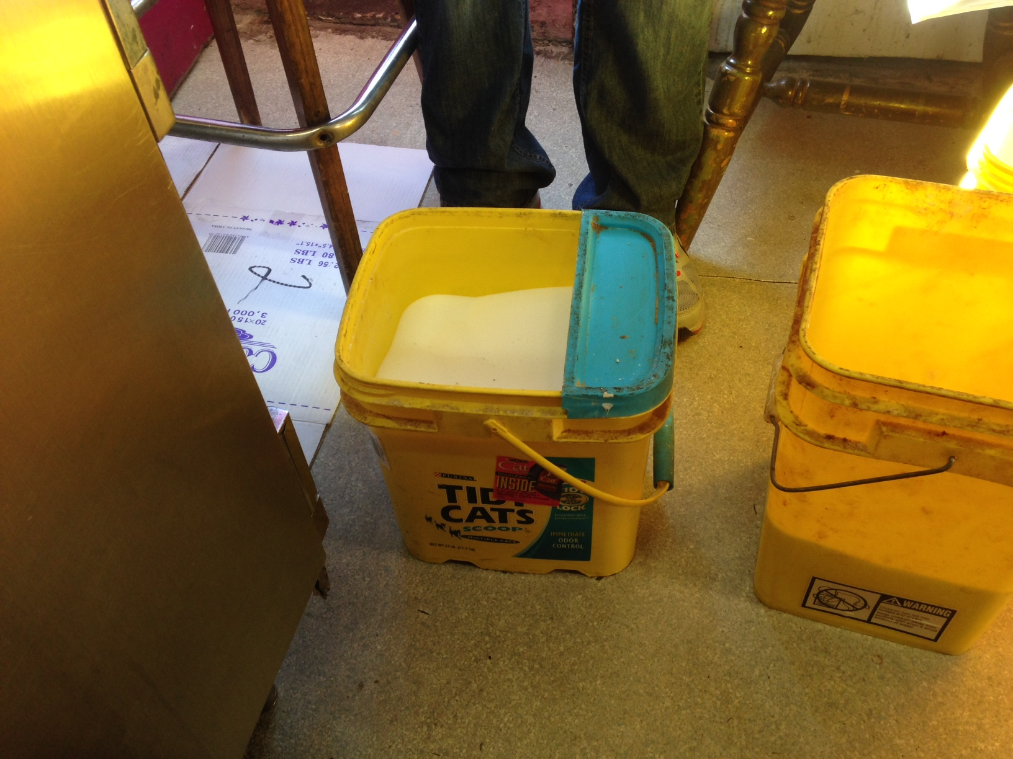
Yuba County Environmental Health

Slide 2
Food Program

Slide 3
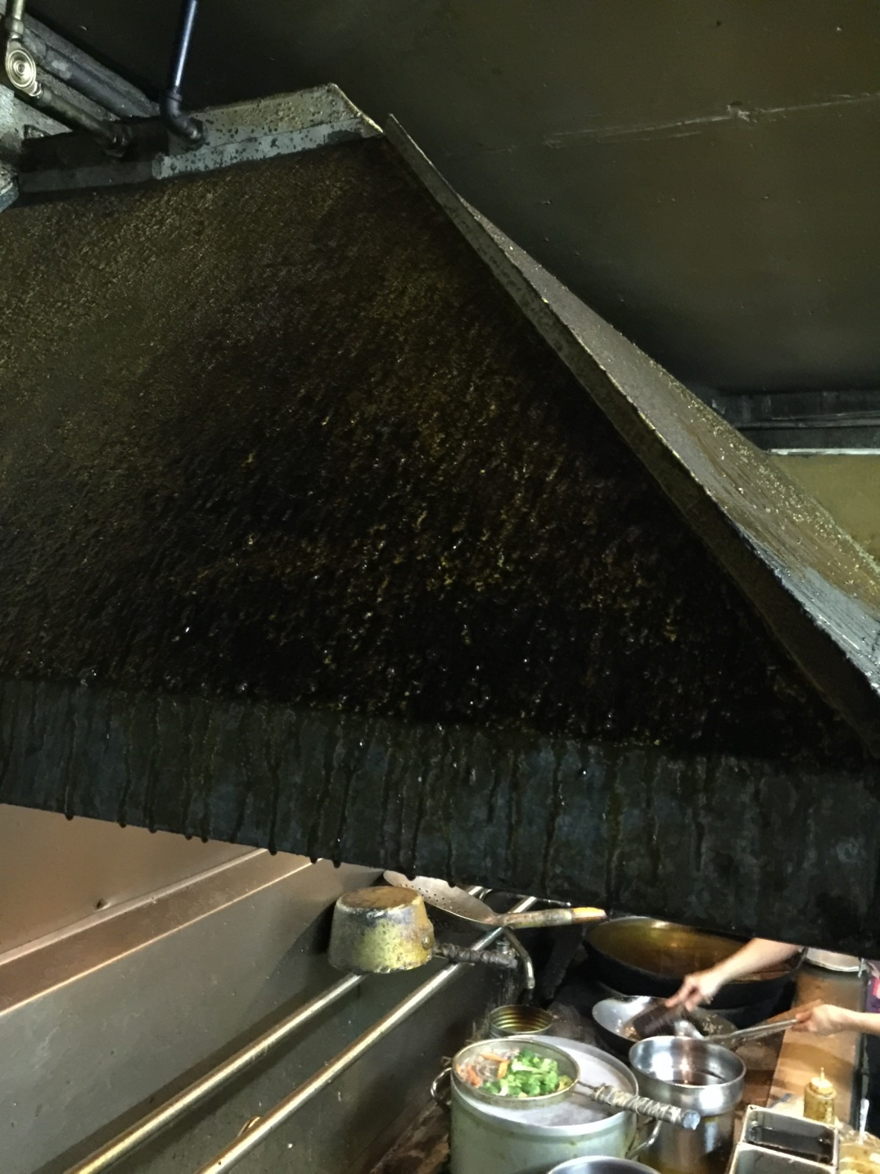
Food Program

Slide 4
Food Program

Slide 5
Public Water Systems

Slide 6
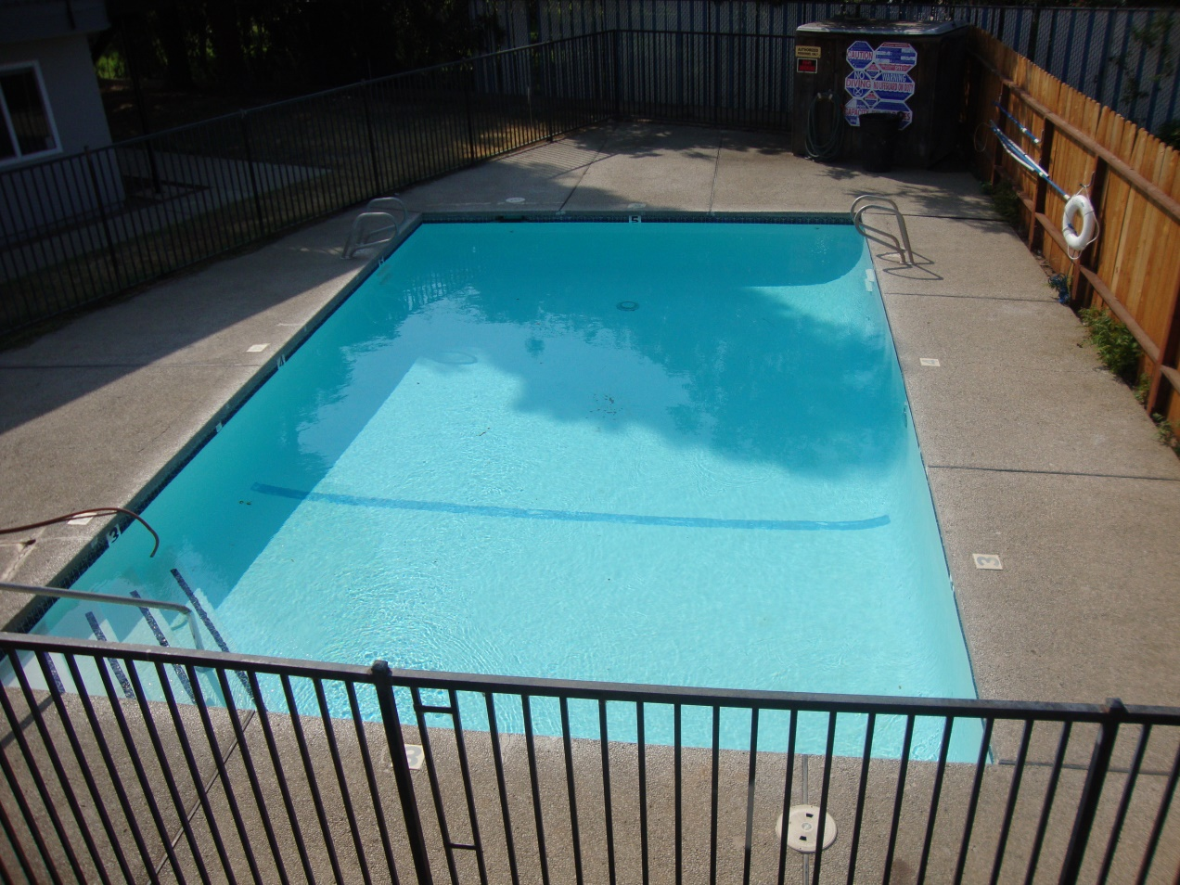
Recreational Health (Swimming Pools)

Slide 7
Waste Tires

Slide 8
Medical Waste

Slide 9
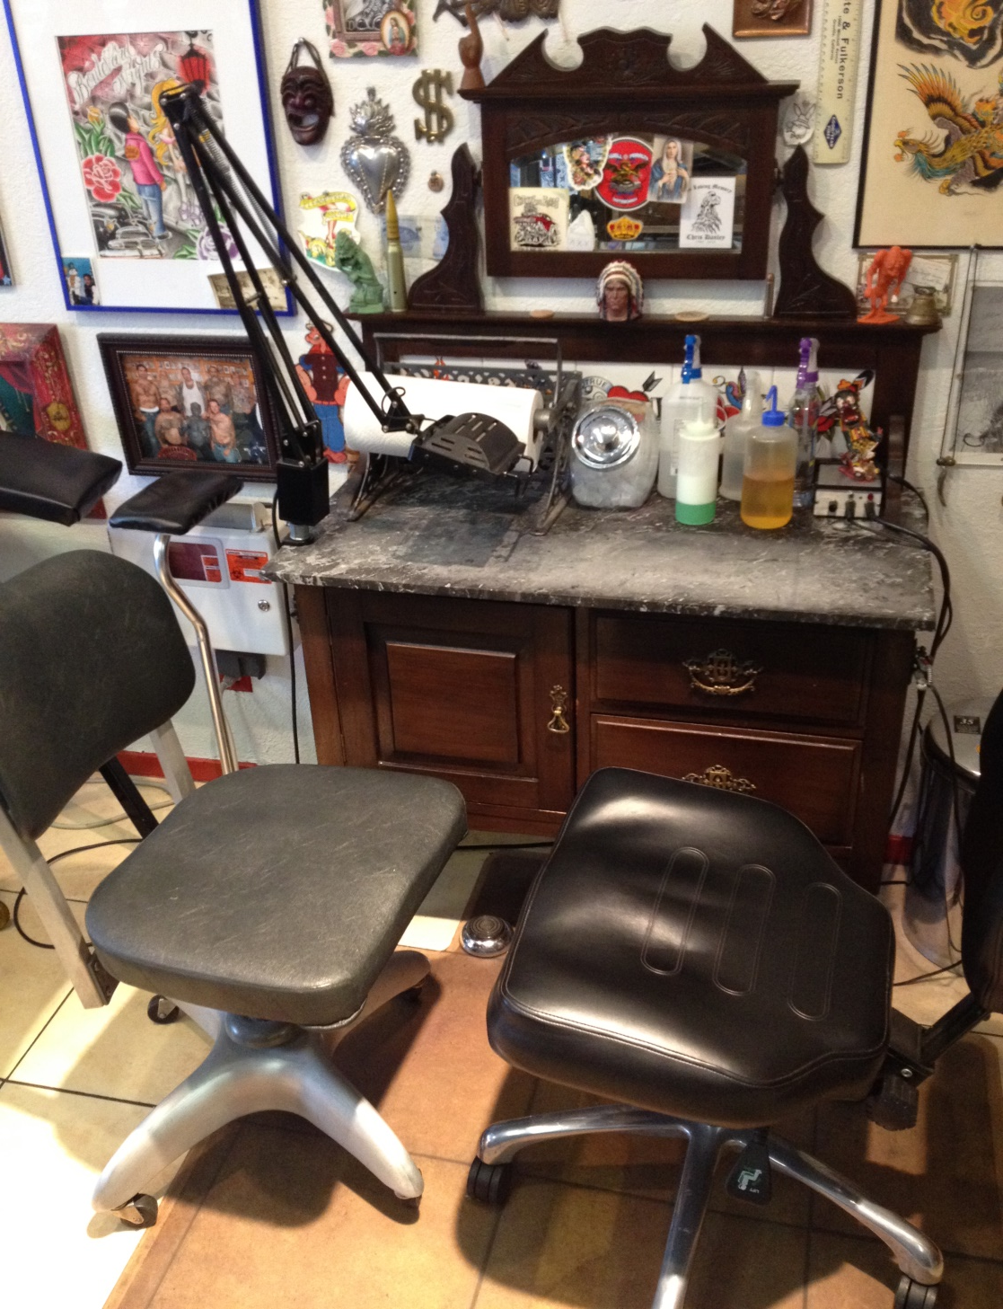
Body Art

Slide 10
Massage Establishments

Slide 11
Public Housing (Hotels/Motels/Camps)

Slide 12
Public Housing

Slide 13
Rabies

Slide 14
Kennels

Slide 15
Solid Waste

Slide 16
Land Use

Slide 17
Liquid Waste (Septic Systems)

Slide 18
Pumper Trucks

Slide 19
Wells

Slide 20
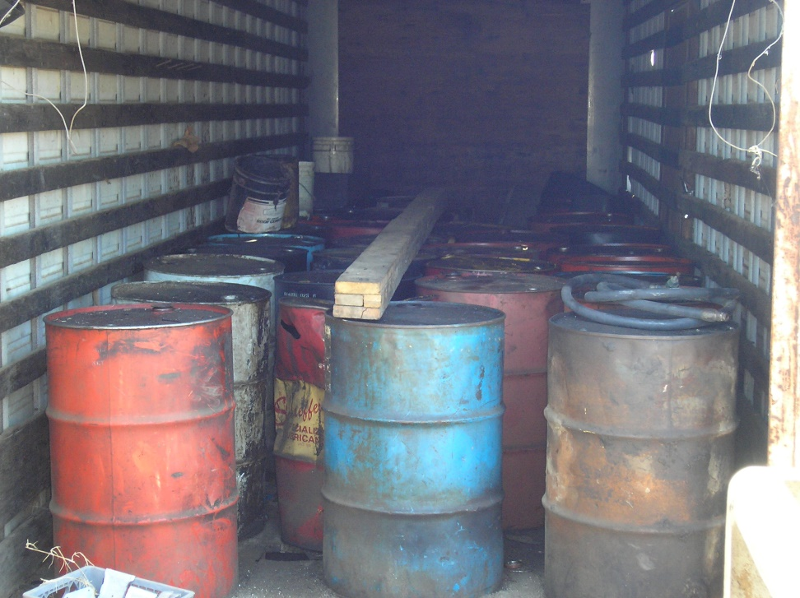
Hazardous Materials

Slide 21
Underground Storage Tanks

Slide 22
Underground Storage Tanks

Slide 23
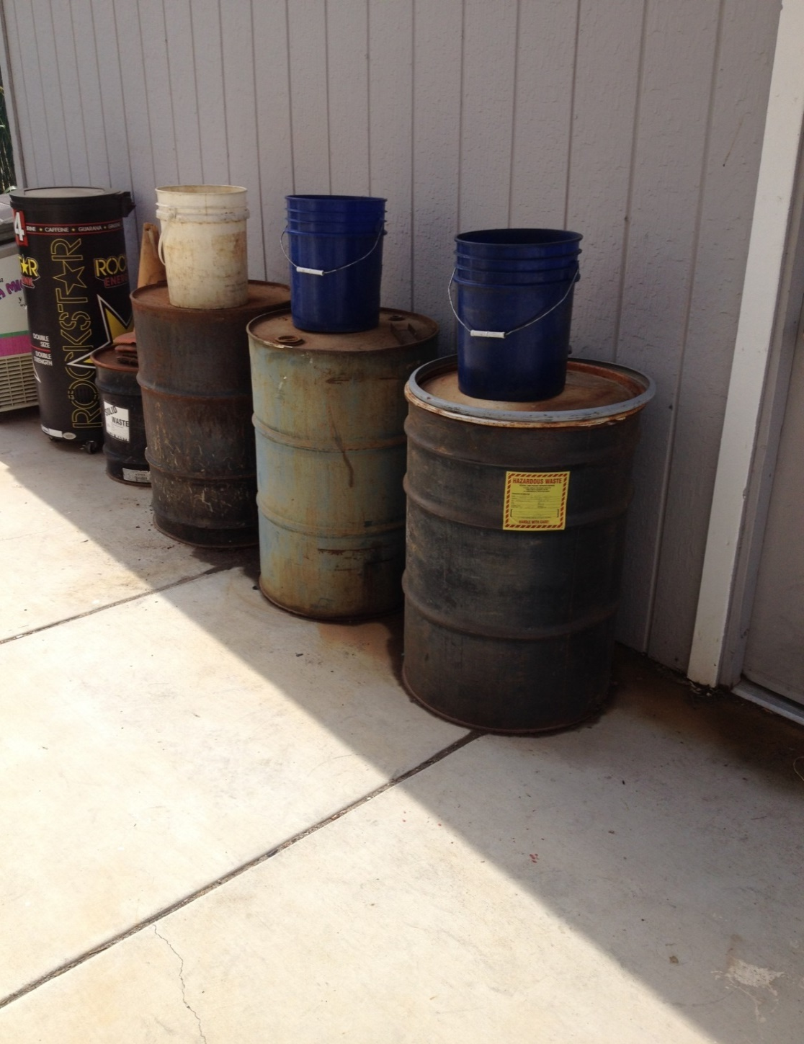
Hazardous Waste

Slide 24
Aboveground Storage Tanks

Slide 25
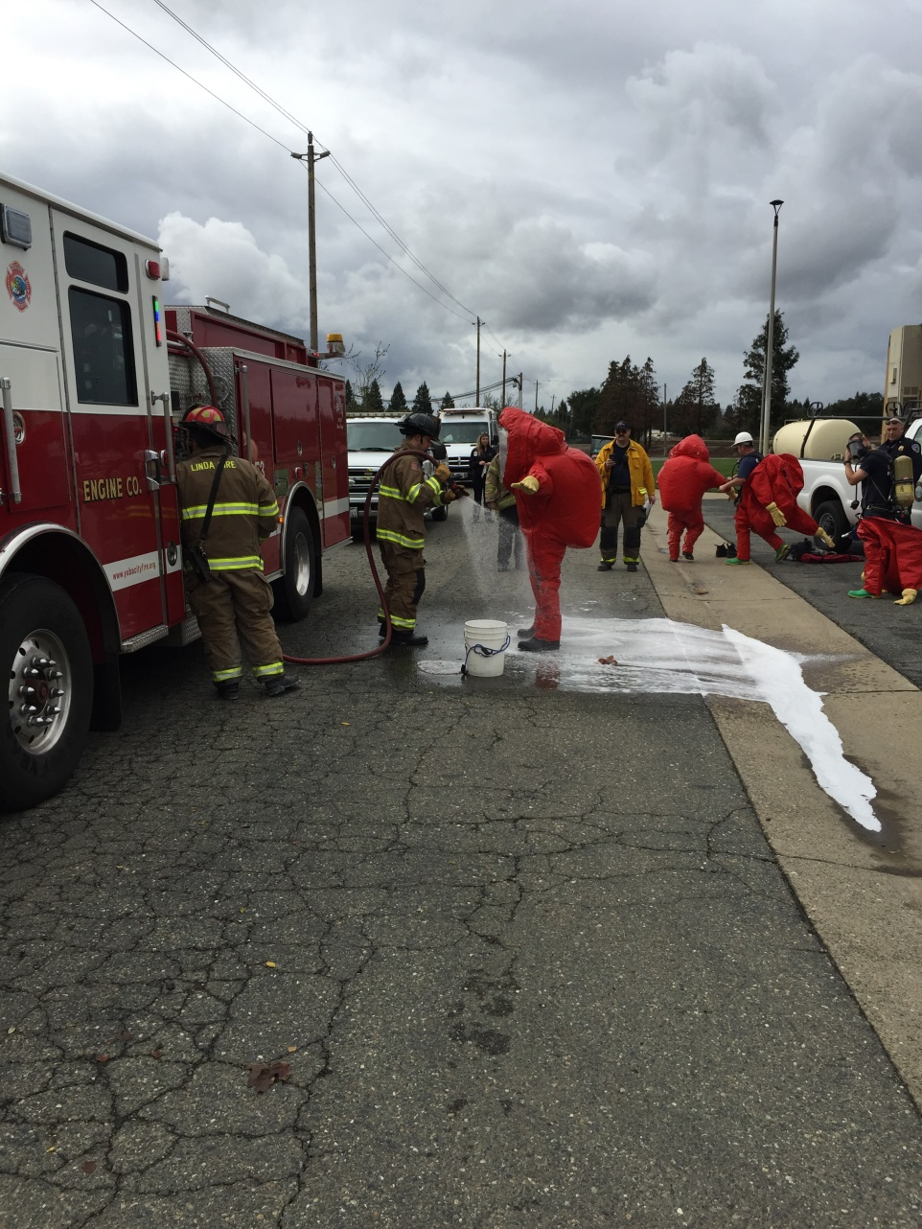
Emergency Response

Slide 26
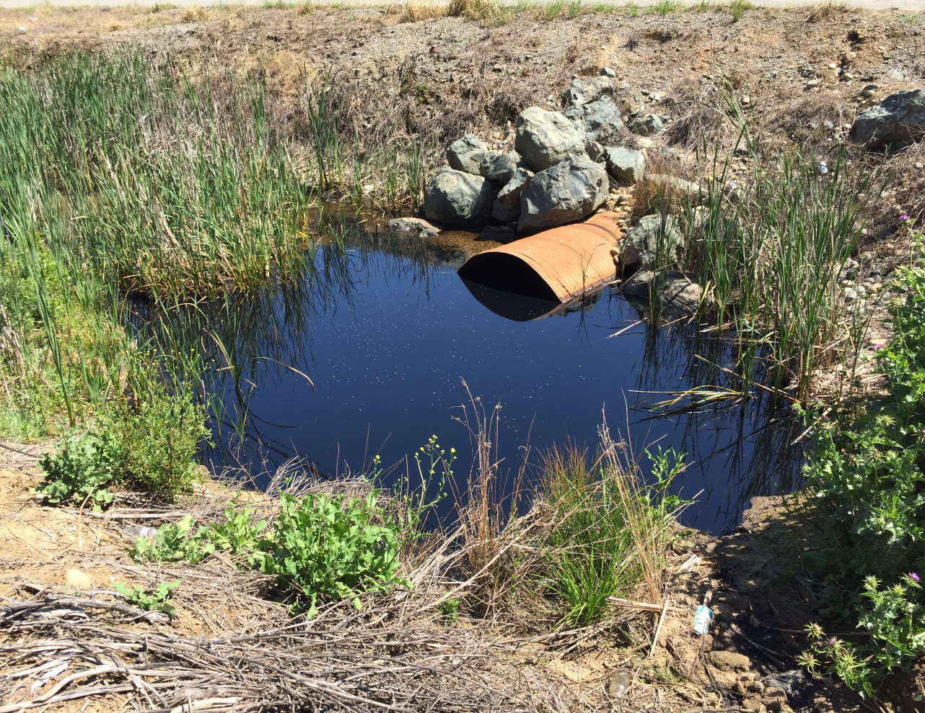
Illegal Dumping

